Slide 1
Basic Details of the Problem Statement
Problem Statement Title:Ideate and Implement a system to enhance the quality of education in rural areas.

Slide 2
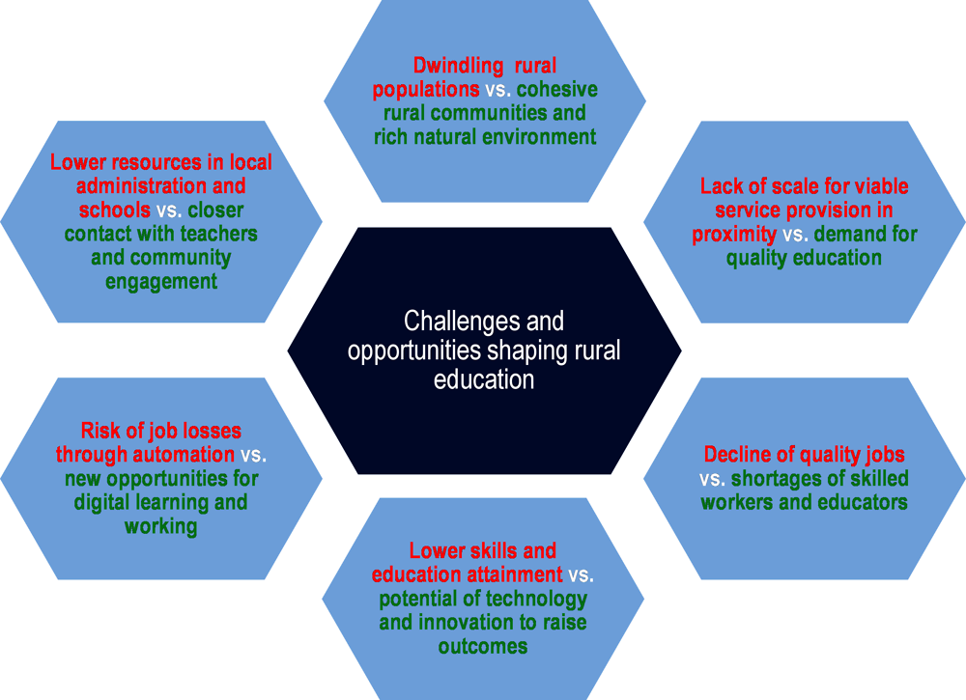
Idea/Approach Details
Add process flow chart or simulated image of prototype or any relevant image related to your idea
Describe your idea/Solution/Prototype here:
A system that introduced in rural education to increase the literacy rate in rural areas and to increase the employment opportunities
The features that include are:
Study material and Mentor Access
Monitoring Skill Progress
Bridge the Digital Divide
Employment Opportunities
Describe your Technology stack here:
WEB and Mobile App Development
Cloud computing
Database Management
Amazon CloudFront
Machine learning
Google Analytics or Custom Analytics
Artificial Intelligence(AI) for Chatbot

Slide 3
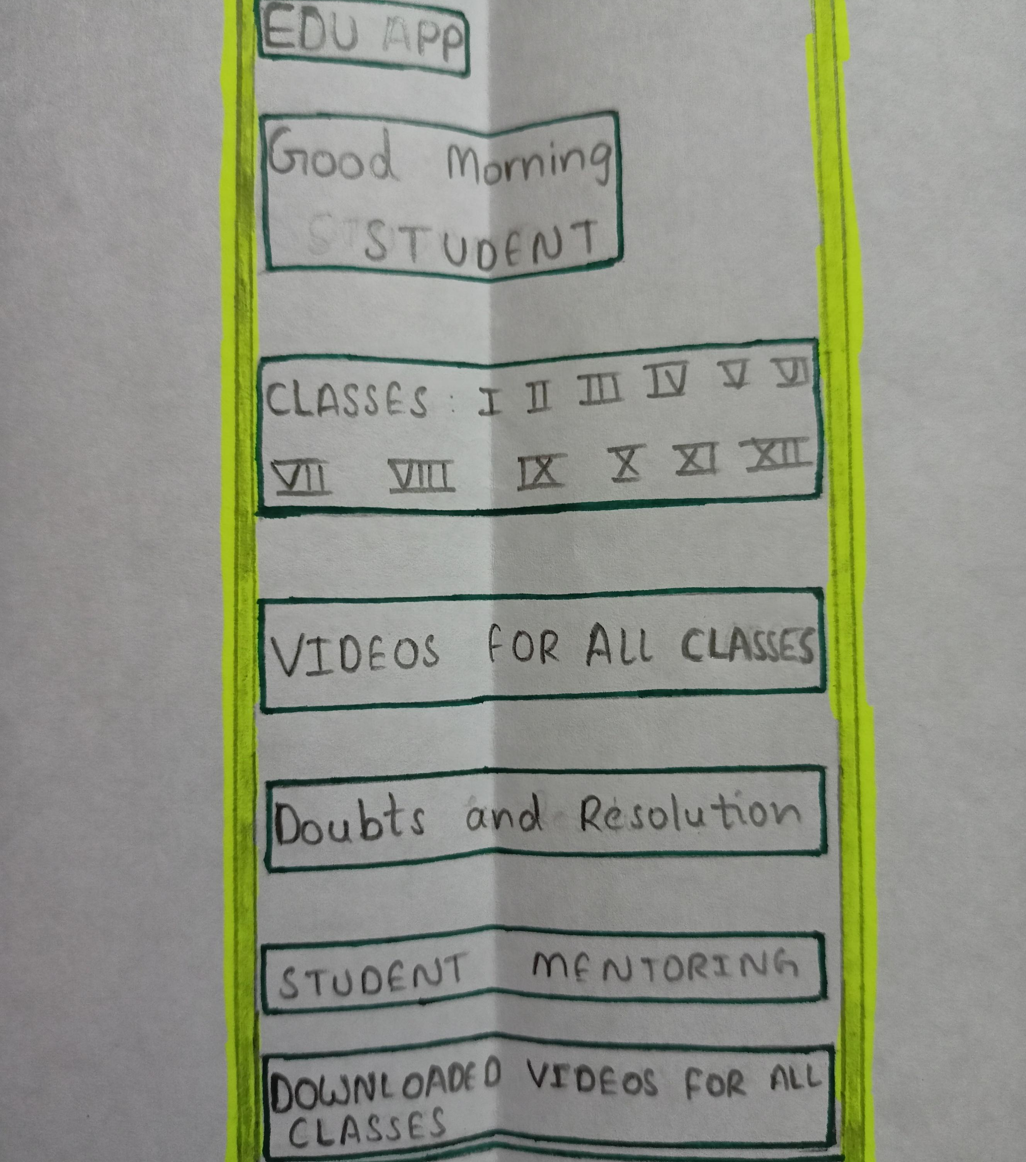
Prototype
For creating the edu app and good morning we use the web development
For creating the classes we use group of objects under clustering process in machine learning
For creating the videos and student mentoring and downloaded video we use classification process in machine learning
For creating the doubt and resolution we use AI and classification process in machine learning

Slide 4
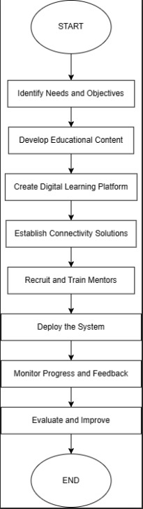
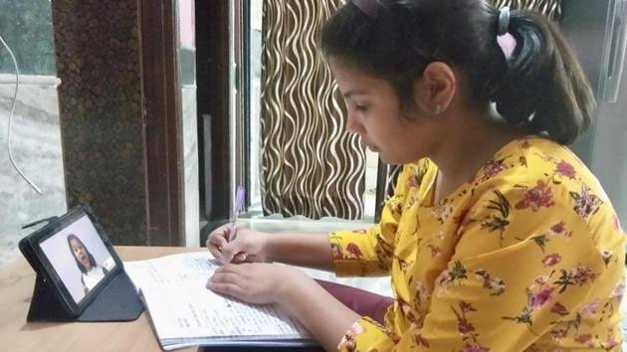
FLOW CHART

Slide 5
USE CASES
DEPENDENCIES
Access to Educational Content
Mentorship and Tutoring
Progress Tracking
Financial Support Information
Healthcare Education
Interactive Learning
Resource Mobilization
Environmental Education
Community Forums and Collaboration
There are some key dependencies:
Technological Dependencies
Educational Content
Financial Dependencies
Human Resources
Infrastructure
Community Involvement
Connectivity and Electricity
Sustainability Plan
Cultural Sensitivity

